Slide 1
Classification

Slide 2
Topics
Definition
MNIST dataset
Binary classification
Accuracy
Confusion Matrix
Precision and Recall
F1
Precision/Recall Trade-off
Precision-Recall Curve
ROC Curve
Multiclass Classification
Multiclass Class Confusion Matrix
Focus on errors
Multilabel Classification
Multioutput Classification

Slide 3
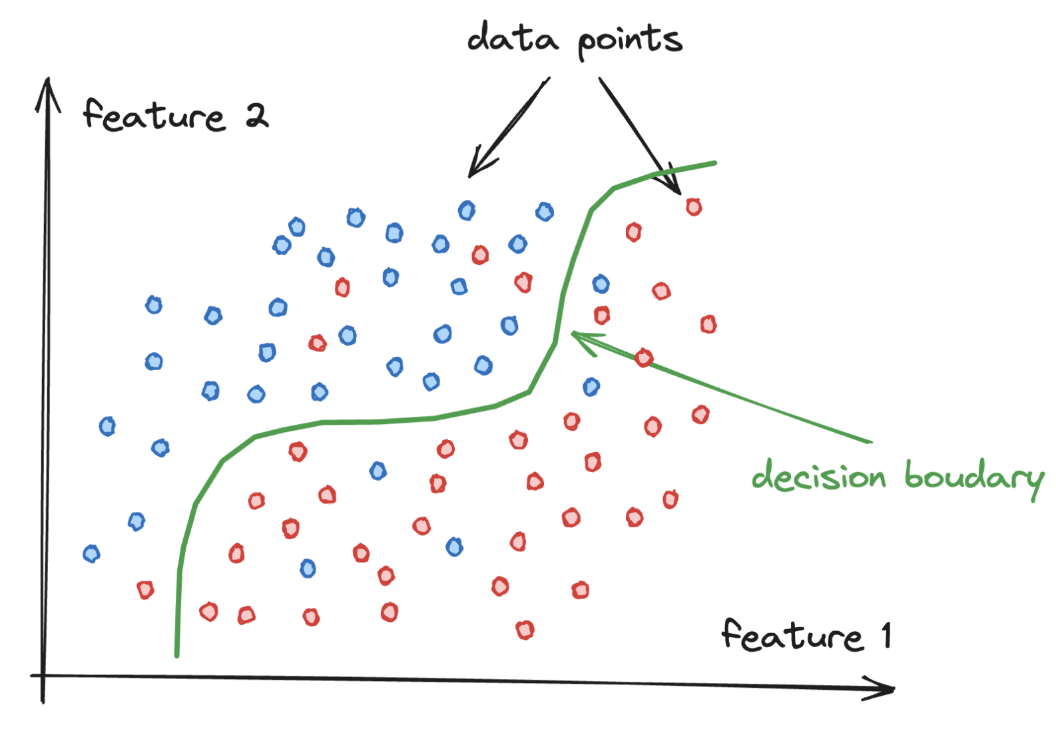
Definition
Classification is a technique used to identify the category of new observations based on training data: decision boundary

Slide 4

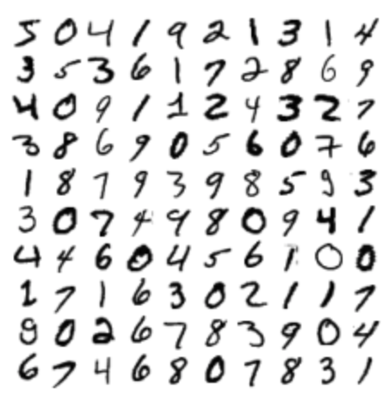
MNIST dataset
A set of 70,000 images of digits handwritten by high school students and employees of the US Census Bureau
each image has 784 features (28×28 pixels)
each feature simply represents one pixel’s intensity from 0 (white) to 255 (black)
each image is labelled with the digit it represents
The dataset has a dictionary structure
DESCR key describing the dataset
data key containing an array with one row per instance and one column per feature
target key containing an array with the labels
We need to create the test set and set it aside before inspecting the data closely
MNIST is already split (training set: 60,000 images, test set: 10,000 images)
The training set is already shuffled to guarantees that all cross-validation folds will be similar

Slide 5
Binary classification
Let’s simplify the problem and try to identify one digit (5)
This detector will be an example of a binary classifier
capable of distinguishing between just two classes (5 and not 5)
A good place to start is a linear model
assume that the two classes can be separated by a straight line or better and more generally by a hyperplane
capable of handling very large datasets efficiently: it deals with training instances independently, one at a time
Evaluating a classifier is significantly trickier than evaluating a regressor
there are many performance measures available
we cannot use RMSE: we don't have a continuous measure
we have right and predicted labels to be compared
we need to define several evaluation metrics specific for this type of problem

Slide 6
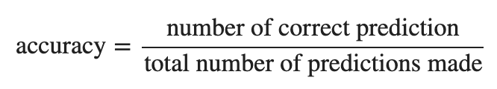
Accuracy
The ratio of correct predictions to the total number of samples
Works well only if there are equal number of samples belonging to each class and if the cost of misclassification of the samples are equal
if we are classifying medical data to find a rare but fatal disease, the cost of failing to diagnose the disease of a sick person is much higher than the cost of sending a healthy person to more tests
We can use K-fold cross-validation to calculate the accuracy
on MNIST we get 95% of accuracy, this looks amazing, doesn’t it?
consider a dumb classifier that just classifies every image as "not-5": 90% accuracy!
because only about 10% of the images are 5s, so if you always guess that an image is not a 5, you will be right about 90% of the time
Accuracy is generally not the preferred performance measure for classifiers, especially when we are dealing with skewed datasets
some classes are much more frequent than others

Slide 7
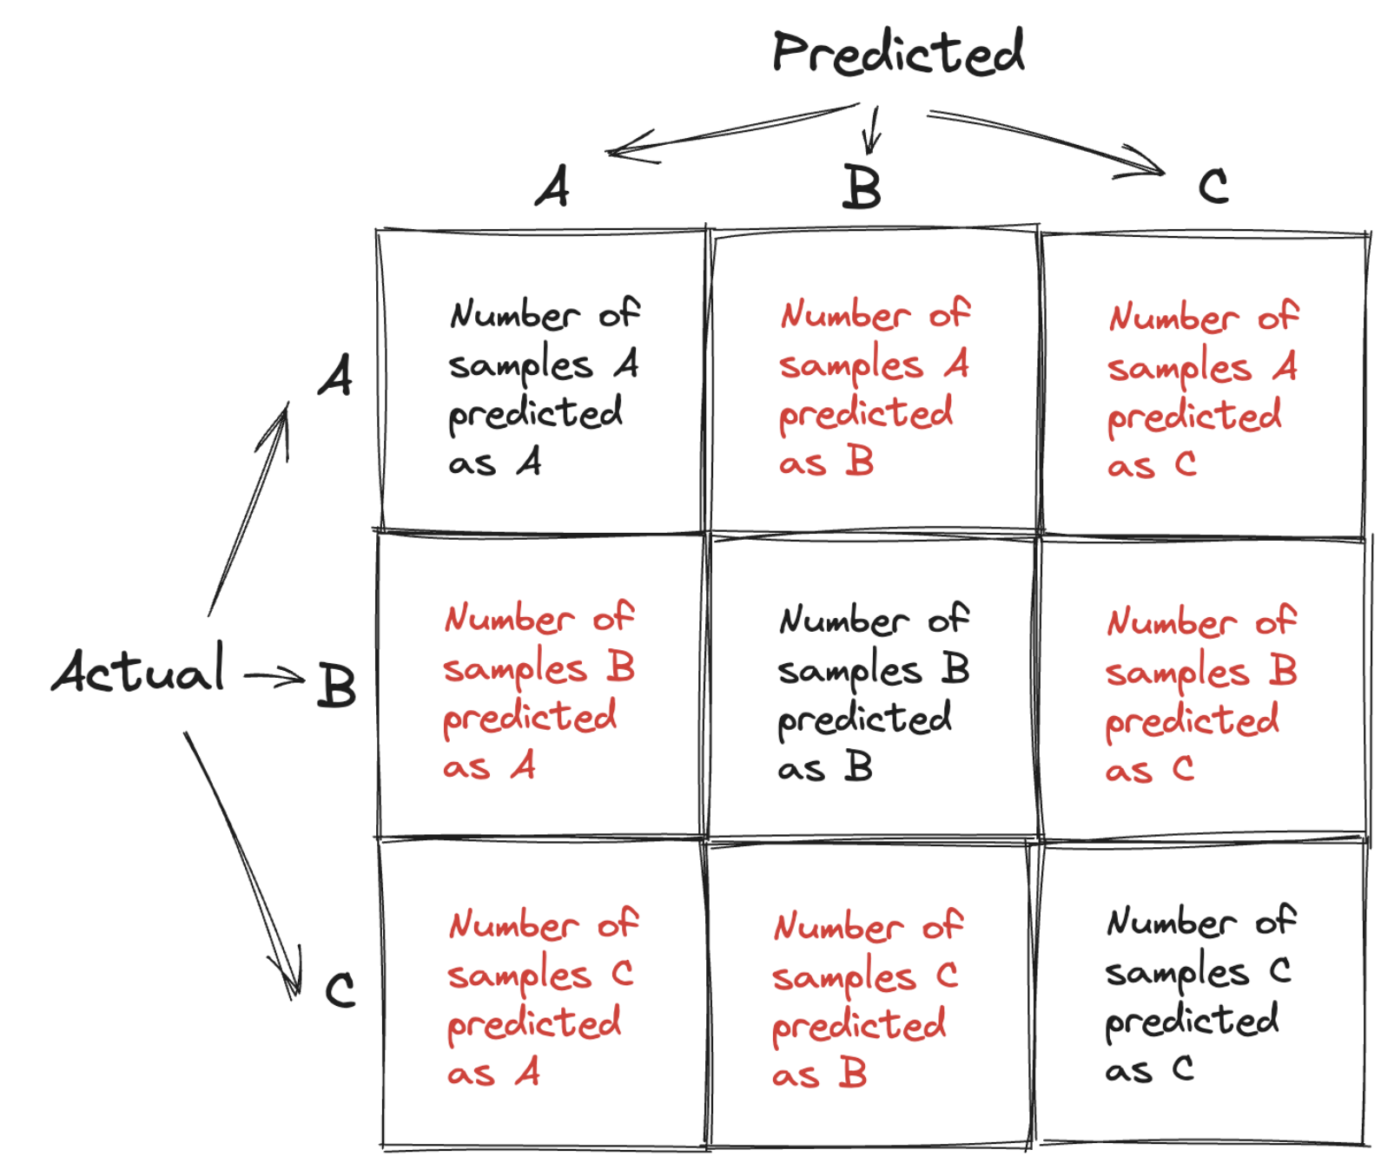
Confusion Matrix
A table to show the number of times instances of a class are misclassified as another class

Slide 8
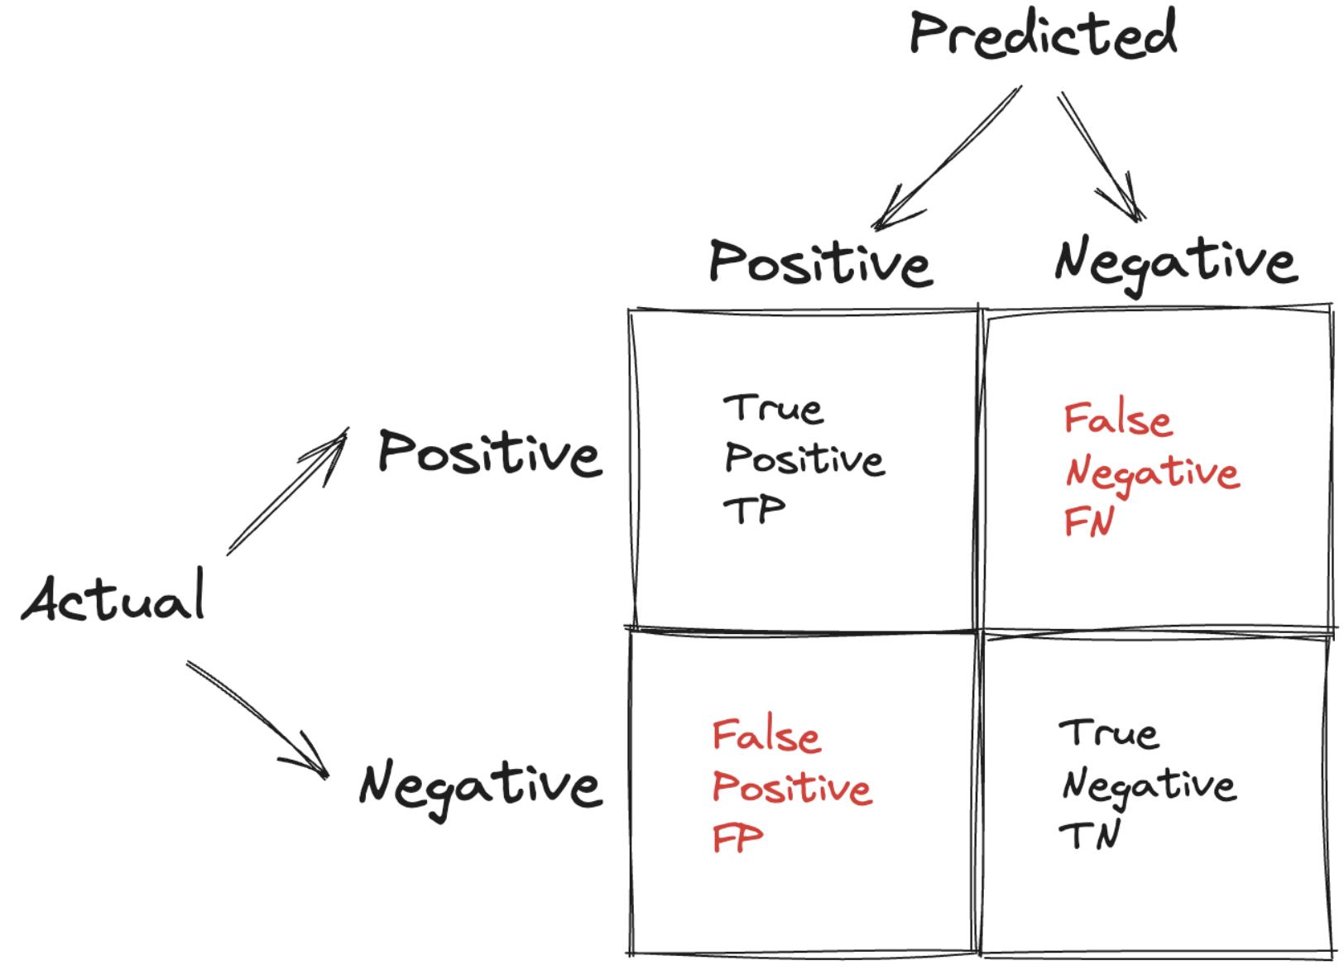
True and false, positive and negative
When we are dealing with a binary classifier, we can have a more concise representation of the confusion matrix using the following terms:

Slide 9
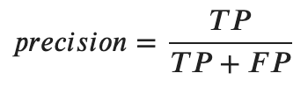
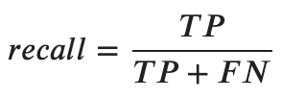
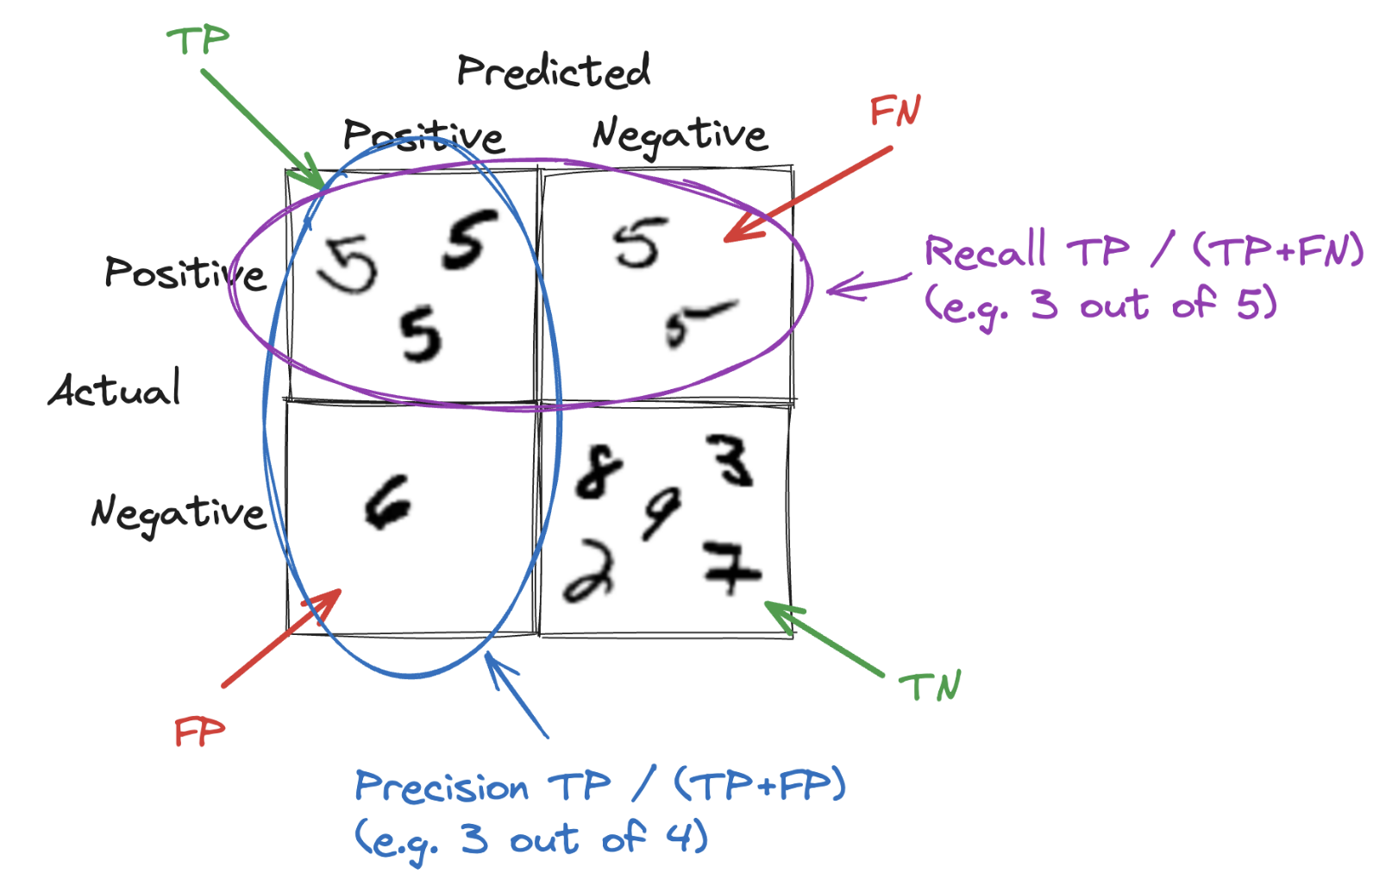
Precision and Recall
Sometimes we may prefer a more concise metrics
Precision: the fraction of relevant instances among the retrieved instances
Recall: the fraction of relevant instances that have been retrieved over the total amount of relevant instances

Slide 10
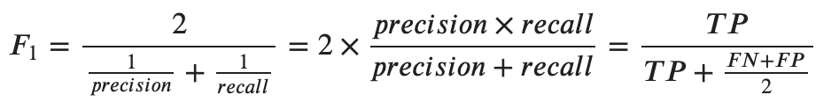
F1
Combination of precision and recall into a single metric
a simple way to compare two classifiers
harmonic mean (reciprocal of arithmetic mean of reciprocals)
The range is [0,1]
tells how precise the classifier is
how many instances it classifies correctly
as well as how robust it is
it does not miss a significant number of instances
The greater the F1 Score, the better is the performance of the model
gives more weight to lower values than standard mean
if either precision or recall is much lower than the other, the F1 score will be closer to the smaller number
in most cases, a high F1 score is desired only when both precision and recall are relatively high

Slide 11
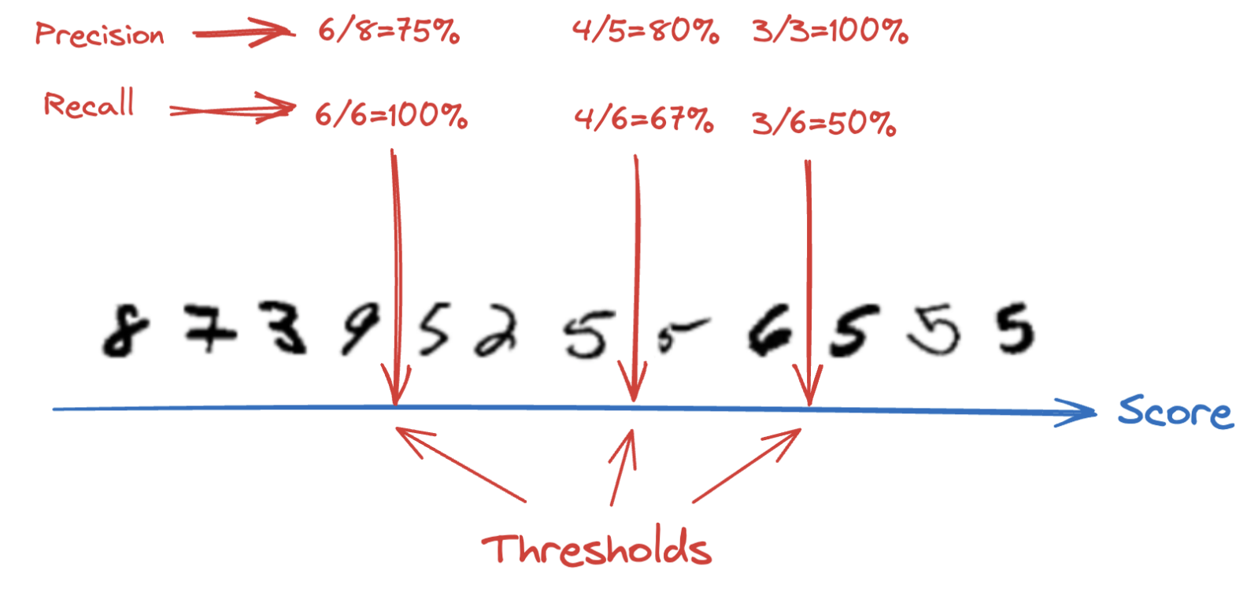
Precision/Recall Trade-off
F1 score favours classifiers that have similar precision and recall
This is not always the case
suppose we need to detect videos that are safe for kids
we probably prefer a classifier that rejects good videos (low recall)
but keeps only safe ones (high precision)
suppose we need to detect shoplifters in surveillance images
it is probably fine if the classifier has low precision (we get a few false alerts)
as long as it has high recall (almost all shoplifters will get caught)
Unfortunately: increasing precision reduces recall, and vice versa

Slide 12
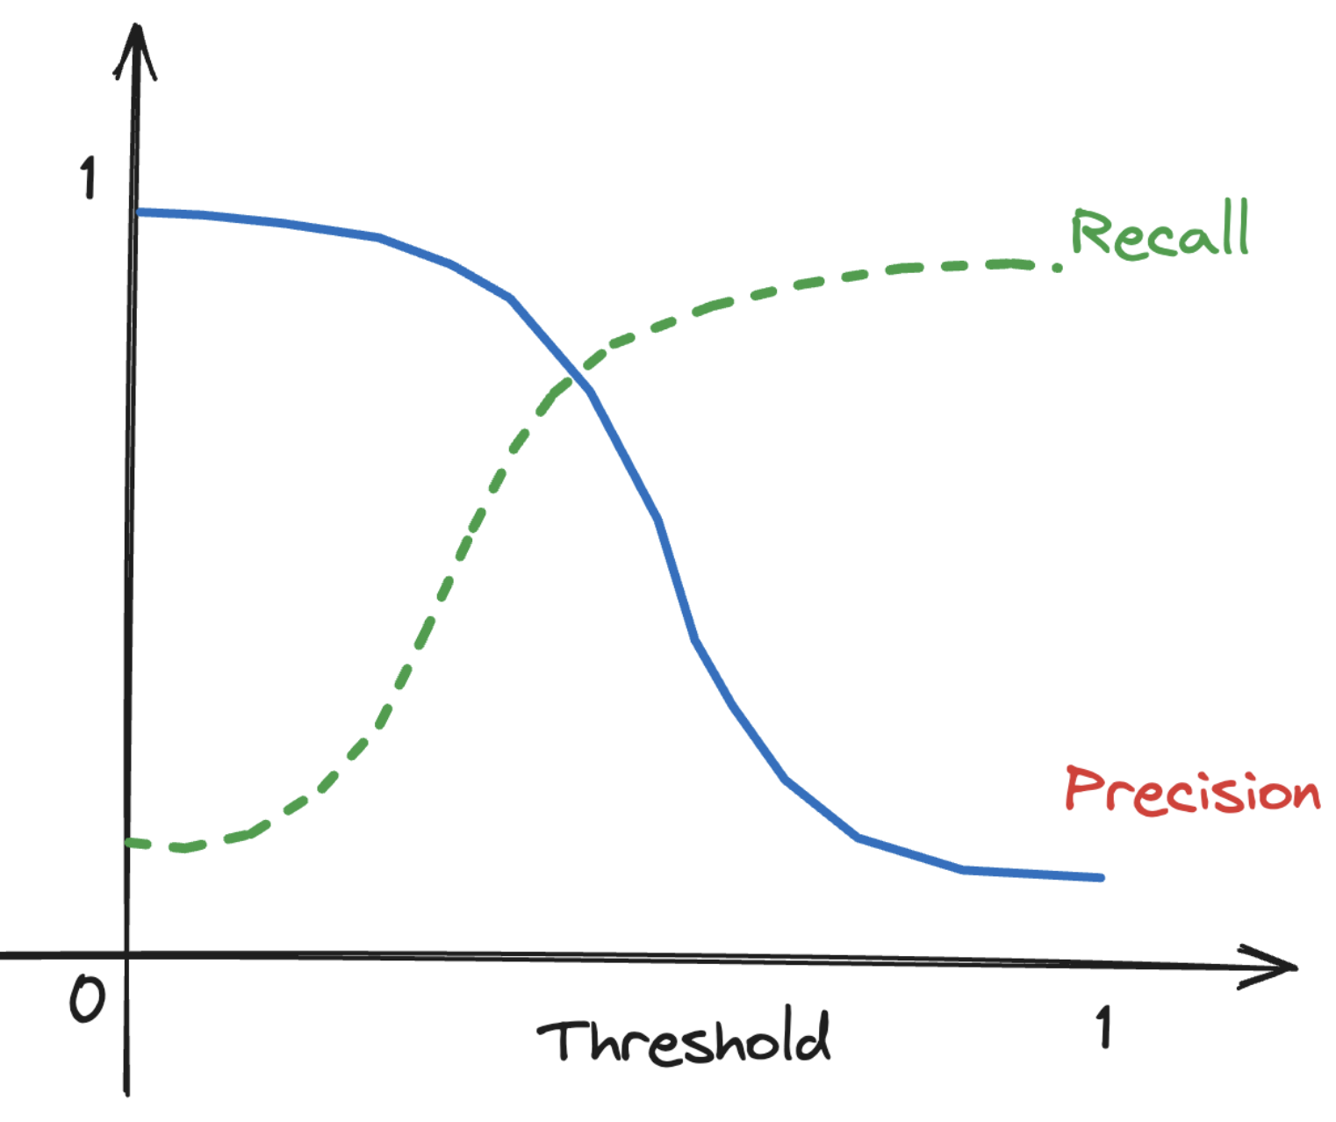
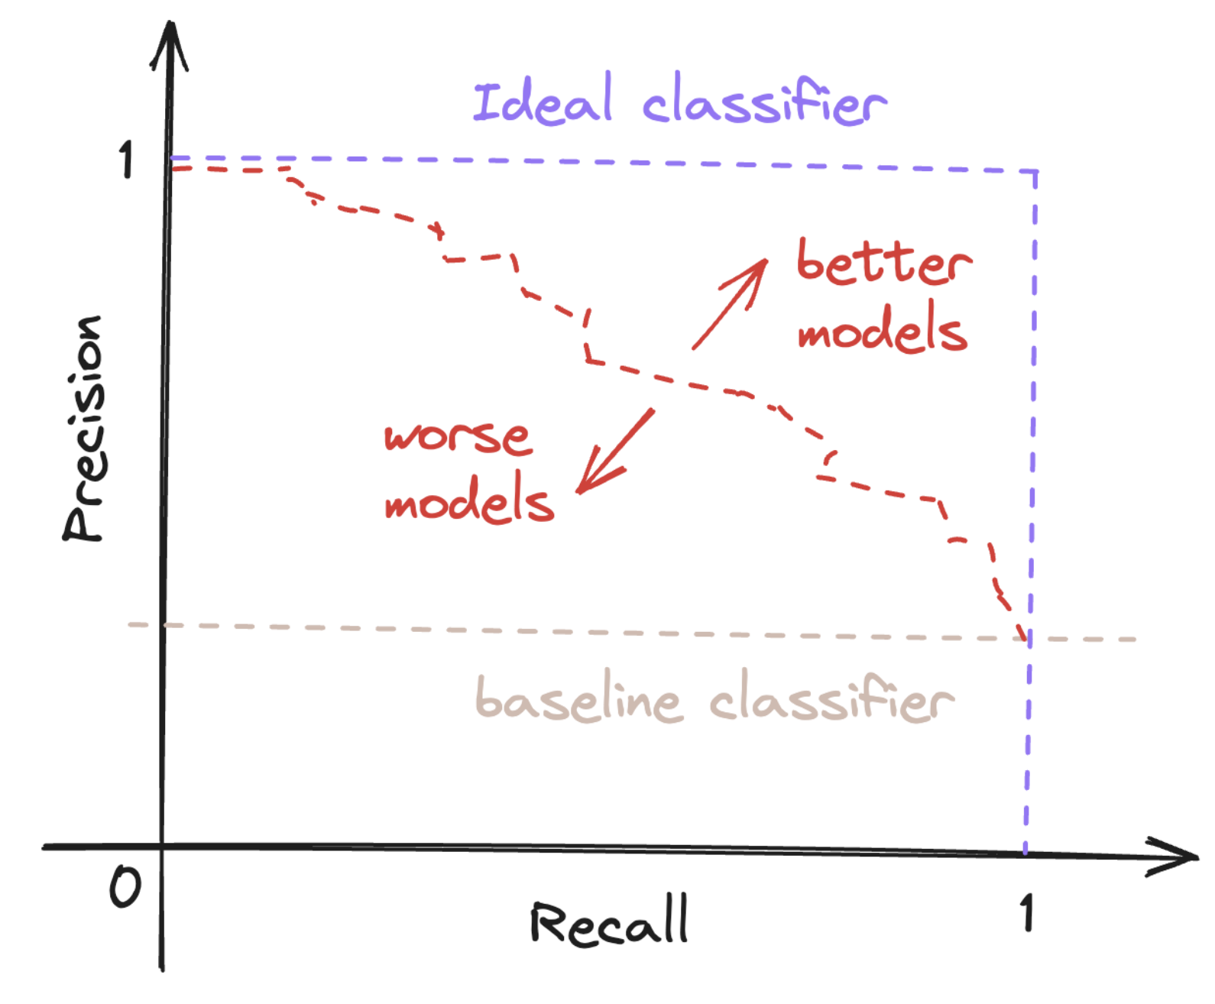
Precision-Recall Curve (1)
How can we decide which threshold to use?
get the decision scores instead of predictions from the training set
compute precision and recall for all possible threshold values
plot precision and recall as functions of the threshold value
or plot precision directly against recall
A good classifier will maintain both a high precision and high recall across the graph, and will "hug" the upper right corner in the figure

Slide 13
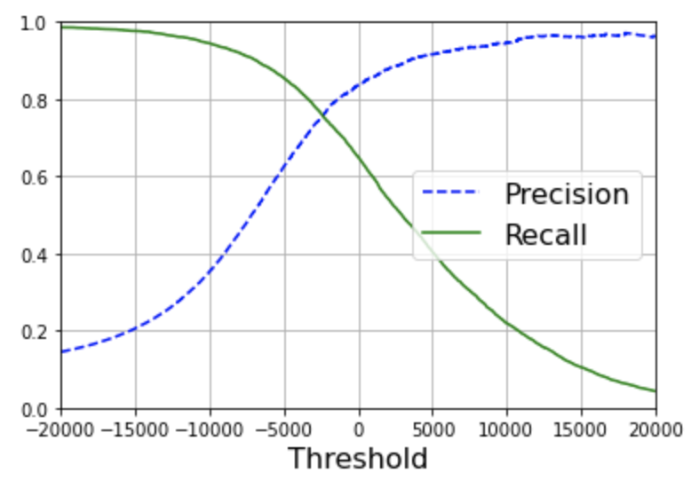
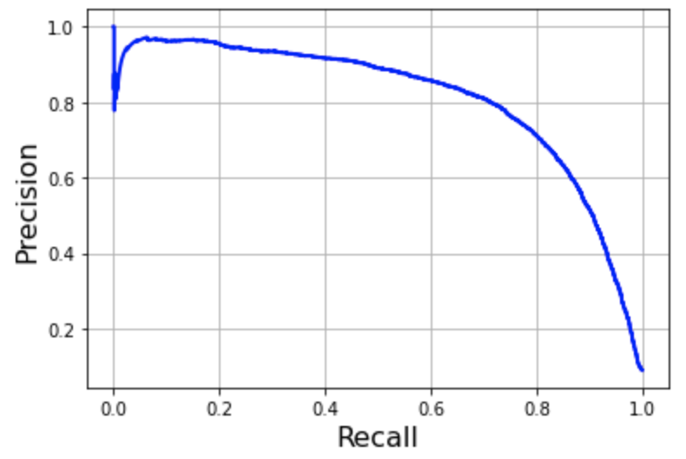
Precision-Recall Curve (2)
In the example:
precision starts to fall sharply around 80% recall
we probably want to select a trade-off just before that drop
the choice depends on the project!
It is easy to create a classifier with virtually any precision
just set a high enough threshold
But at what recall?

Slide 14
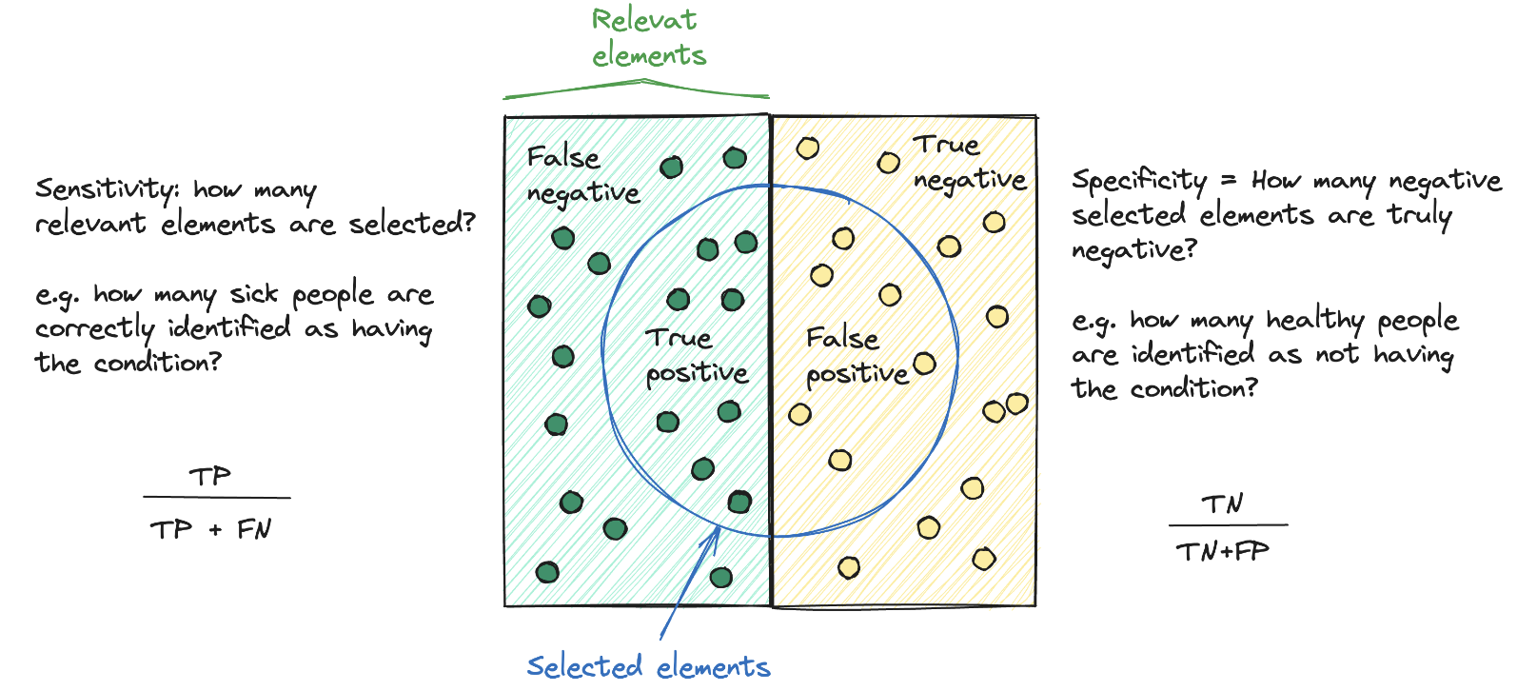
ROC Curve (1)
Receiver Operating Characteristic (ROC) curve

Slide 15
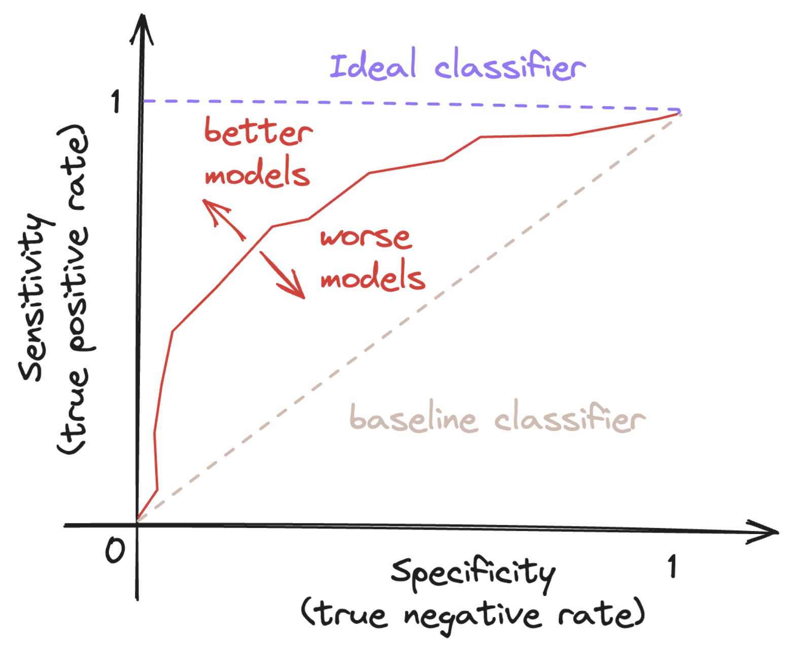
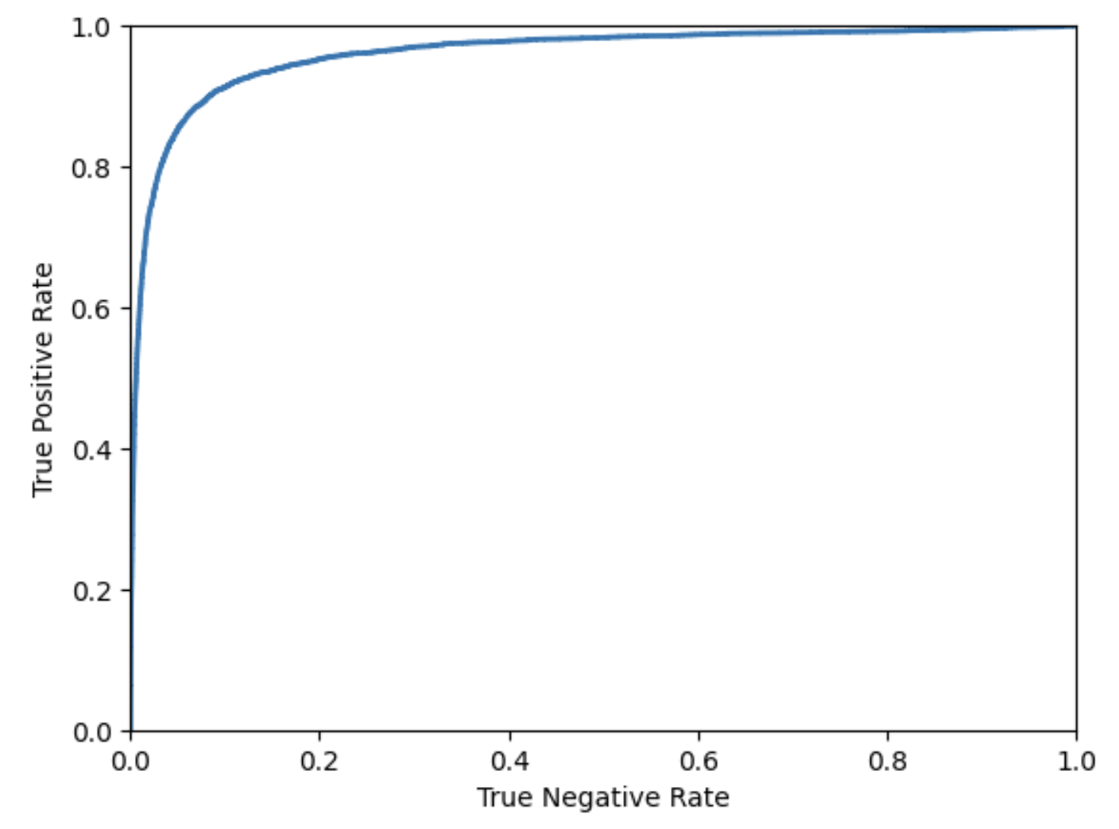
ROC Curve (2)
Similar to precision/recall curve, how to decide?
prefer the precision/recall whenever the positive class is rare
otherwise, use the ROC curve
Area under the curve ROC AUC
perfect classifier ROC AUC = 1
random classifier ROC AUC = 0.5
In the example:
looking at the ROC curve, we may think that the classifier is good
precision-recall curve makes it clear that the classifier has room for improvement

Slide 16
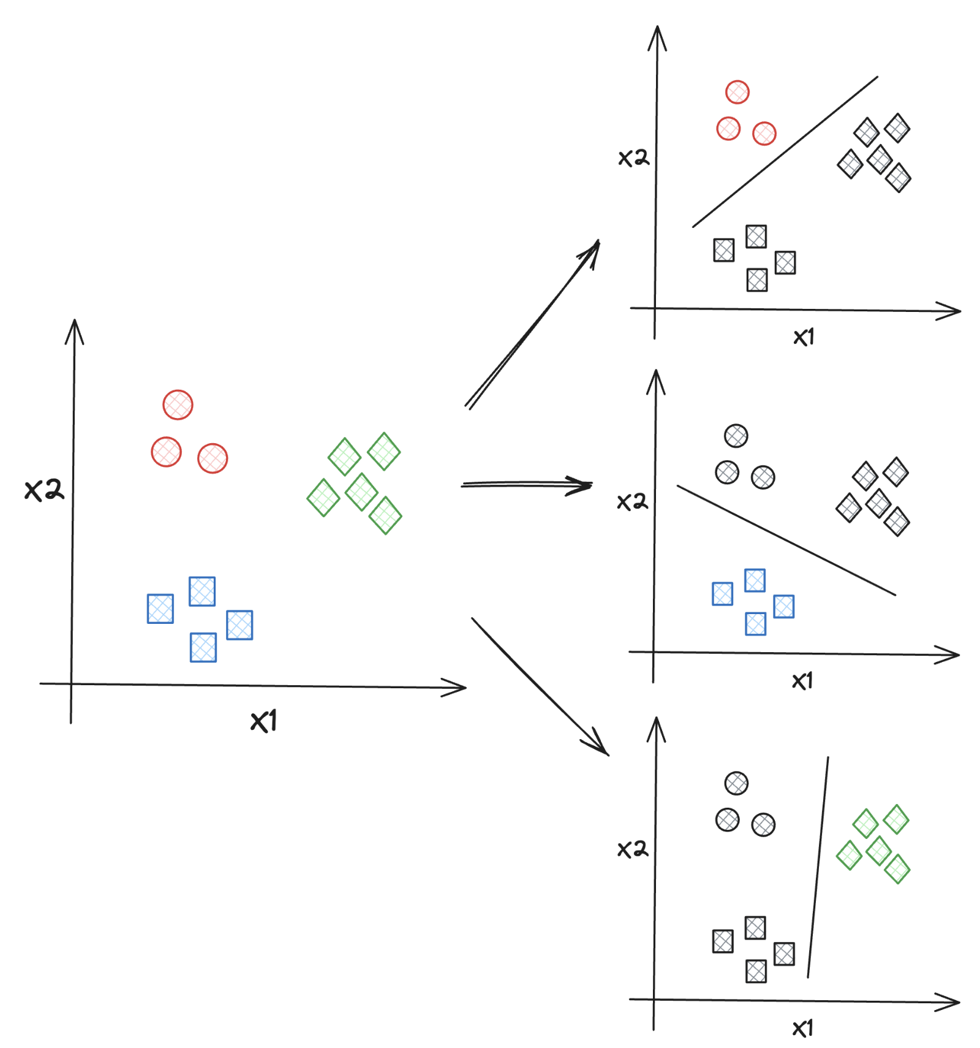
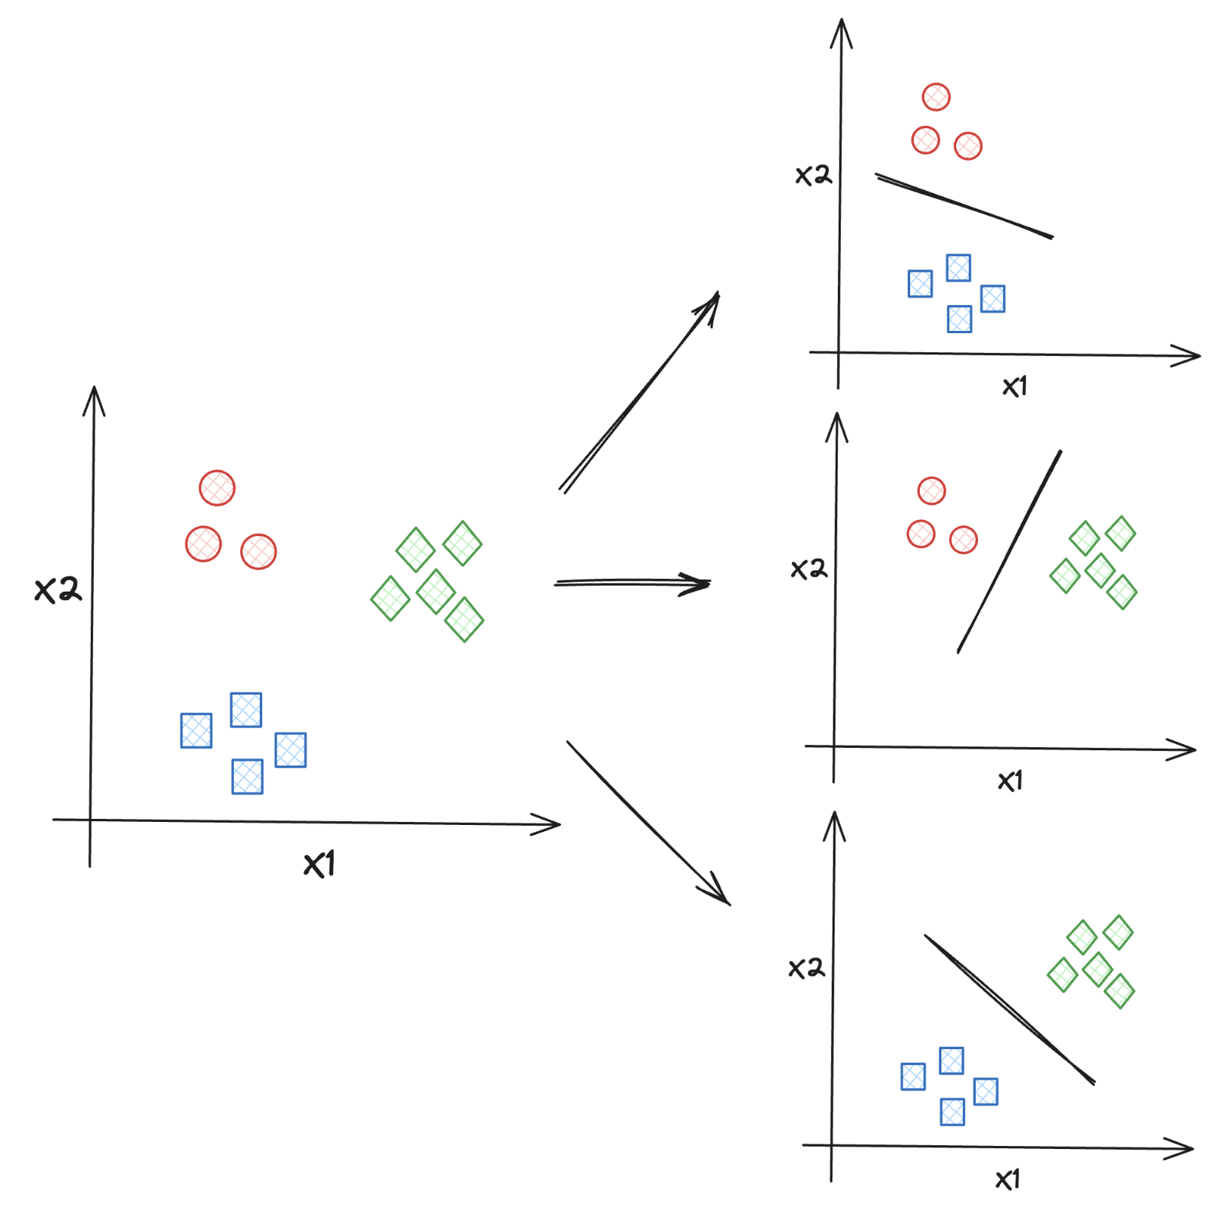
Multiclass Classification
A multiclass classifiers can distinguish between more than two classes
some algorithms are capable of handling multiple classes natively
others are strictly binary classifiers
One-versus-all strategy (OvR)
train N binary classifiers, one for each class
get the decision score from each classifier
select the class whose classifier outputs the highest score
One-versus-one strategy (OvO)
train a binary classifier for every pair of classes
with N classes, we need to train N×(N–1)/2 classifiers
run an item through all classifiers and see which class wins most duels
advantage: each classifier only needs to be trained on the part of the training set for the two classes that it must distinguish

Slide 17
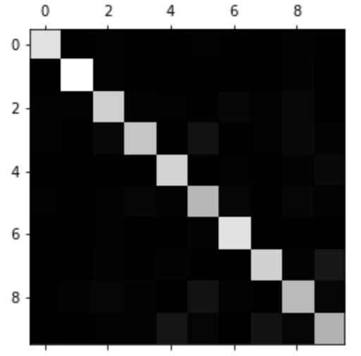
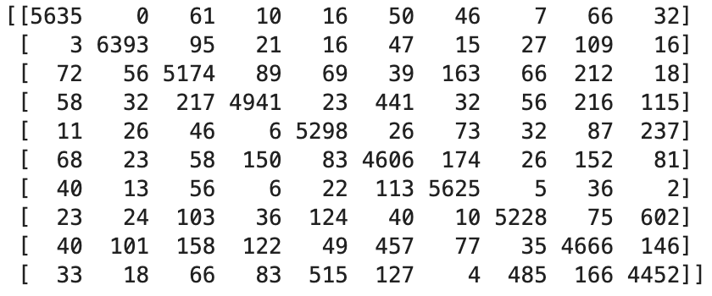
Multiclass Class Confusion Matrix
We can evaluate the classifier using cross-validation
We can look at the confusion matrix to analyse the types of errors:
Confusion matrix looks pretty good
most images are on the main diagonal (classified correctly)
Linear Model

Slide 18
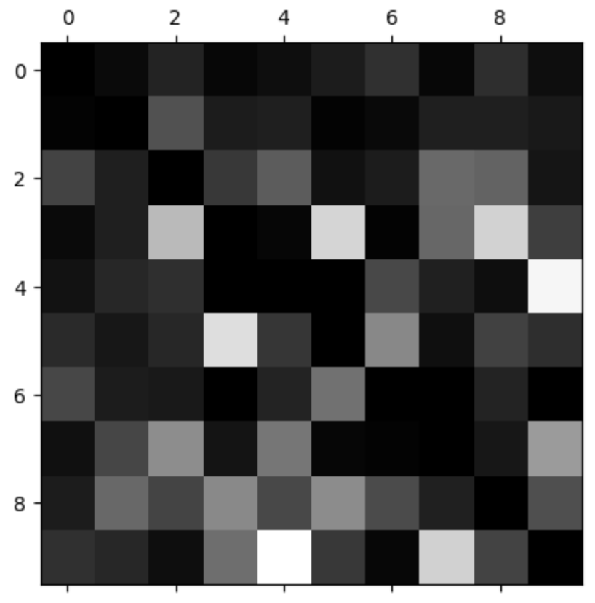
Focus on errors (1)
We can focus the plot on errors
divide values by the number of images in the corresponding class
to compare error rates instead of absolute numbers
then fill the diagonal with zeros
to keep only the errors
We can see the kinds of errors:
column of 8 is quite bright: many images get misclassified as 8
row of class 8 is not bad: actual 8 get properly classified
3s and 5s often get confused (in both directions)
Analysing individual errors is a way to gain insights on what the classifier is doing and why it is failing
difficult and time-consuming

Slide 19
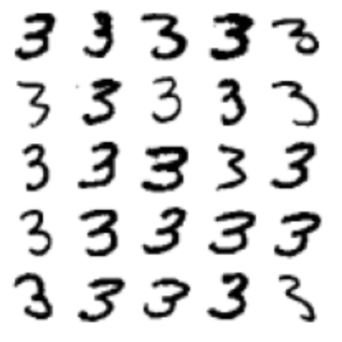
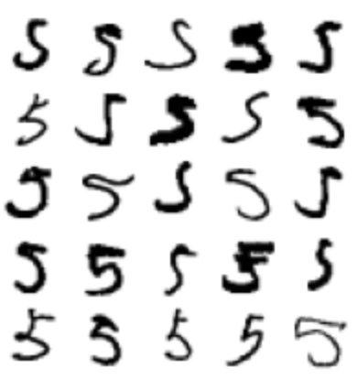
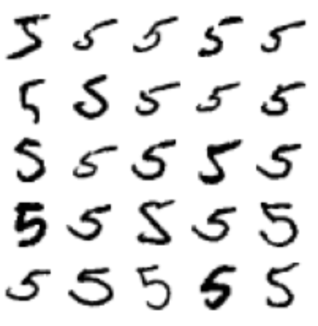
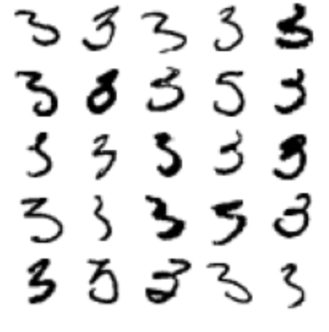
Focus on errors (2)
Some of the digits wrong classified are so badly written that even a human would have trouble classifying them
Most misclassified images seem like obvious errors to us: it’s hard to understand why the classifier made the mistakes it did
The reason is that we used a simple linear model
all it does is assign a weight per class to each pixel
when it sees a new image, it just sums the weighted pixel intensities to get a score
since 3 and 5 differ only by a few pixels, this model will easily confused by them
Digits classified as 3
Digits classified as 5

Slide 20
Multilabel Classification
Until now each instance has always been assigned to just one class
We may want our classifier to output multiple classes for each instance
Let’s look at a simple example
two target labels for each digit image
the first indicates whether or not the digit is large (7, 8, or 9)
the second indicates whether or not it is odd
We can use a K-Neighbors Classifier (which supports multilabel classification)
There are many ways to evaluate a multilabel classifier
selecting the right metric really depends on the project
precision and recall for each class
measure F1 score for each individual label, then compute the average score
this assumes that all labels are equally important
compute a weighted average using the number of true instances for each label
this accounts for label imbalance

Slide 21

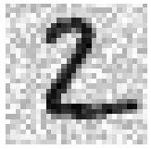

Multioutput Classification
A generalization where each label can be multiclass
it can have more than two possible values
As an example, consider a system that removes noise from images
take as input a noisy digit image
output a clean digit image, represented as an array of pixel intensities
Notice:
the classifier output is multilabel (one label per pixel)
each label can have multiple values (pixel intensity ranges from 0 to 255)
Using a KNN on a noised MNIST dataset
MNIST Image
Noised Image
Reconstructed Image

Slide 22
Exercise
1 - Try to build a classifier for the MNIST dataset that achieves over 97% accuracy on the test set. Hint: the KNeighborsClassifier works quite well for this task: you just need to find good hyperparameter values (try a grid search on the weights and n_neighbors hyperparameters).
2 - Write a function that can shift an MNIST image in any direction (left, right, up, or down) by one pixel. Then, for each image in the training set, create four shifted copies (one per direction) and add them to the training set. Finally, train your best model on this expanded training set and measure its accuracy on the test set. You should observe that your model performs even better now! This technique of artificially growing the training set is called data augmentation

